Slide 1


Investment Insights – IFA Update
For financial advisers only
Date:
October 2026
Presented by:
John Wyn-Evans
Head of Market Analysis
Rathbones

Slide 2
Main themes
Bond market concerns
Equity profits
AI boom
It’s not a bubble!
UK Budget
US mid-terms
The case for balanced portfolios

Slide 3
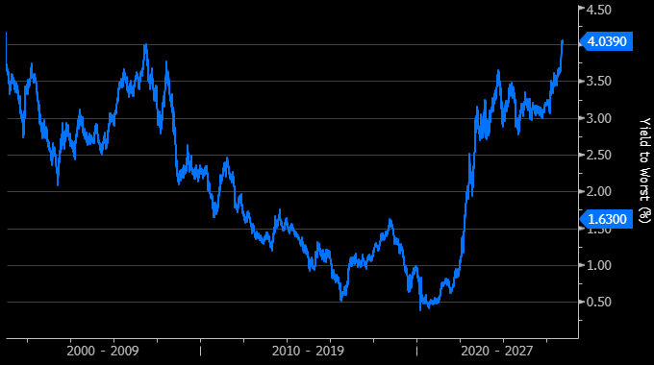
Bond market concerns
Bloomberg Global Treasuries Index Yield (2000 – 2026)
Source: Bloomberg – 06/10/2026

Slide 4
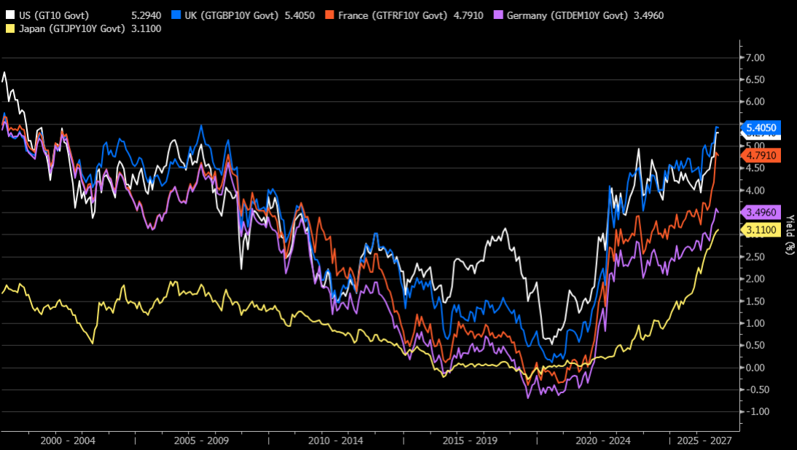
Bond market concerns
Global 10-Year Bond Yields (2000 – 2026)
Source: Bloomberg – 06/10/2026

Slide 5
Bond market concerns
Why?
Fears about fiscal deficits
Rising inflation
Crowding out’ (mainly a function of the huge debt issuance of hyperscalers competing with governments)
A higher ‘neutral rate’ of interest (thanks to higher growth – not the worst thing)
A rising term premium (the extra yield demanded to account for uncertainty)
Correlation with nominal GDP growth

Slide 6
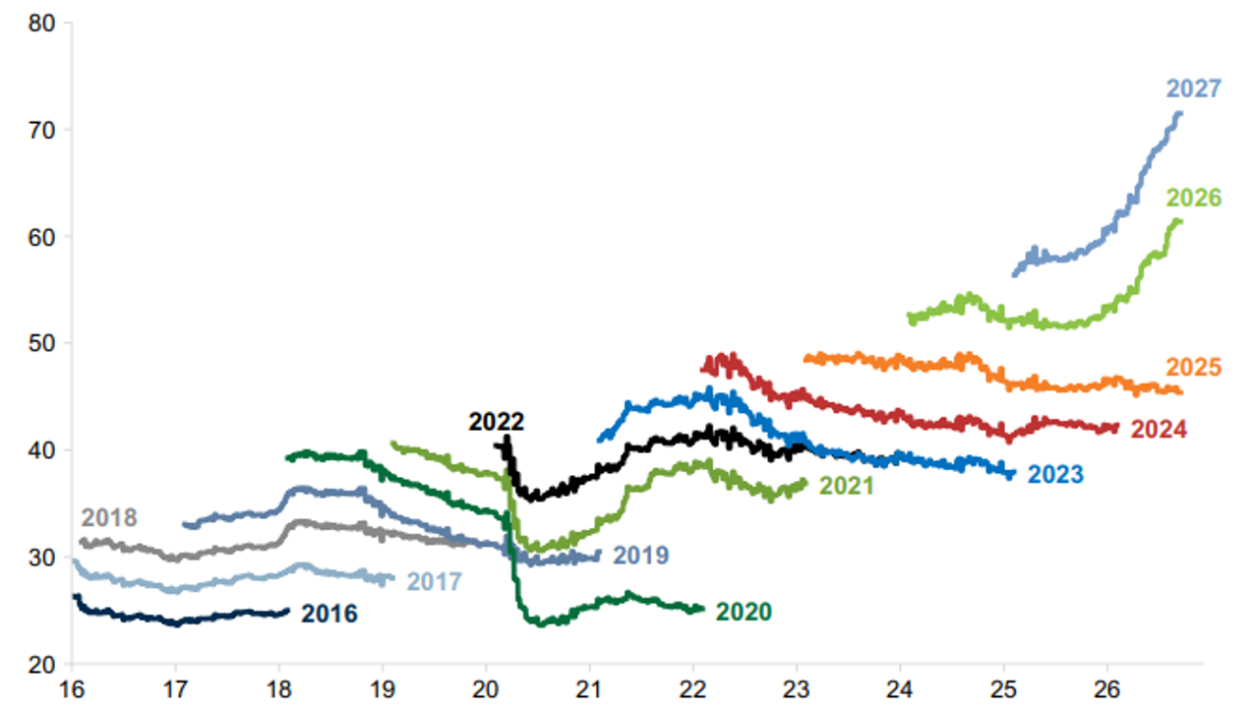
The tug of war - equities fight back
Global earnings growth projections – MSCI All-Countries World Index
Source: Goldman Sachs - September 2026

Slide 7
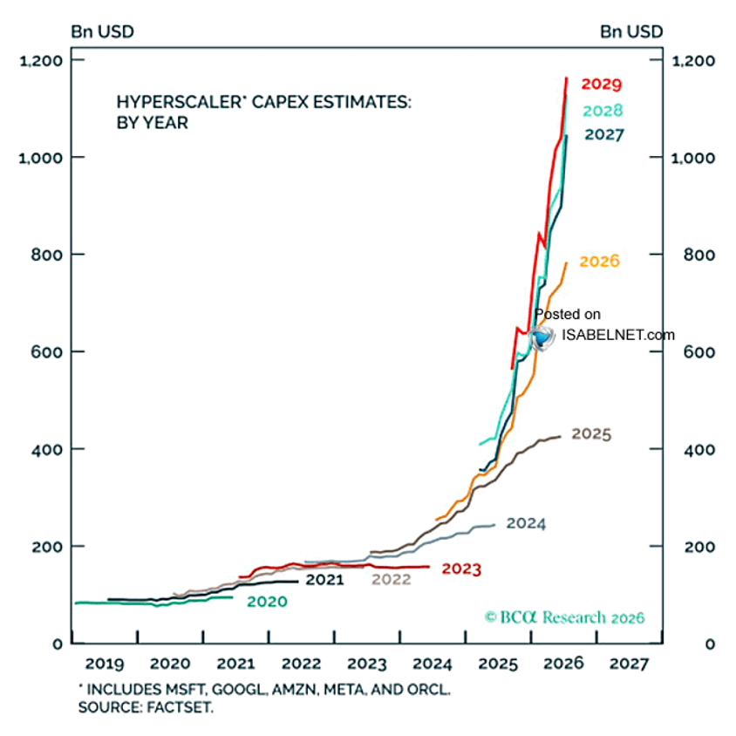
The AI boom
Hyperscaler Capex estimates
Source: BCA Research - September 2026

Slide 8
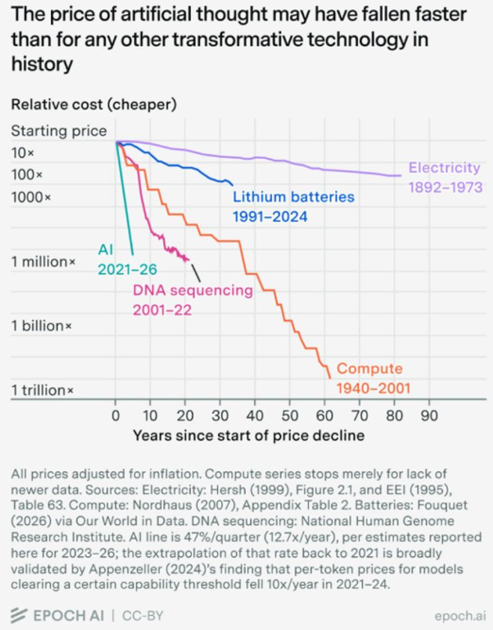
The AI boom
Jevons paradox in action?
Source: EPOCH AI - September 2026

Slide 9
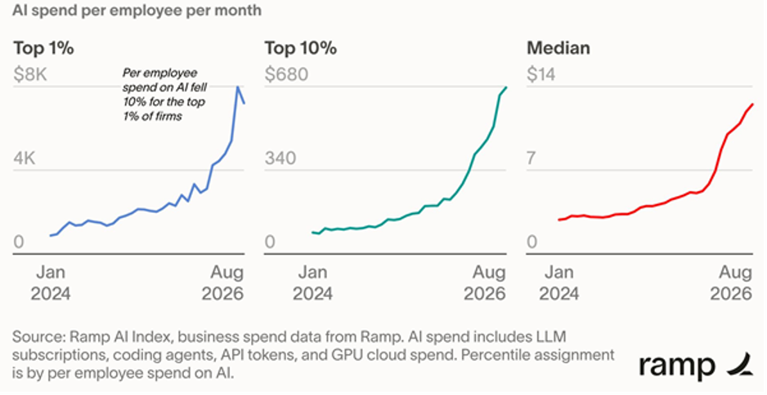
The AI boom
Still A long way to go
Source: ramp - September 2026

Slide 10
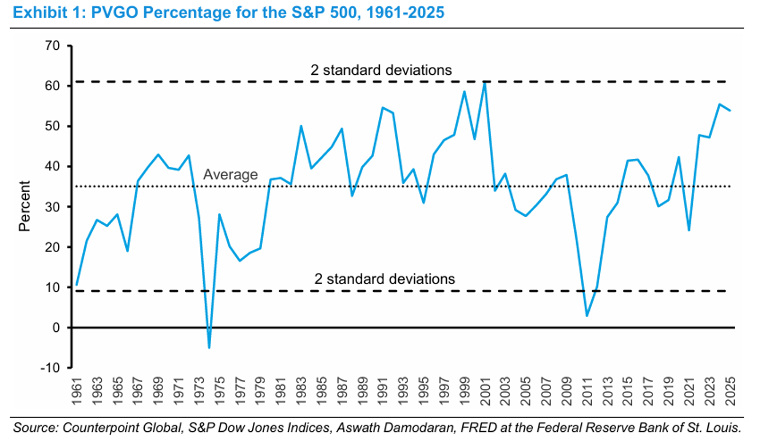
Is it a bubble?
Lots of “The Future” priced in today – present value of future growth
Source: Counterpoint Global - June 2026

Slide 11
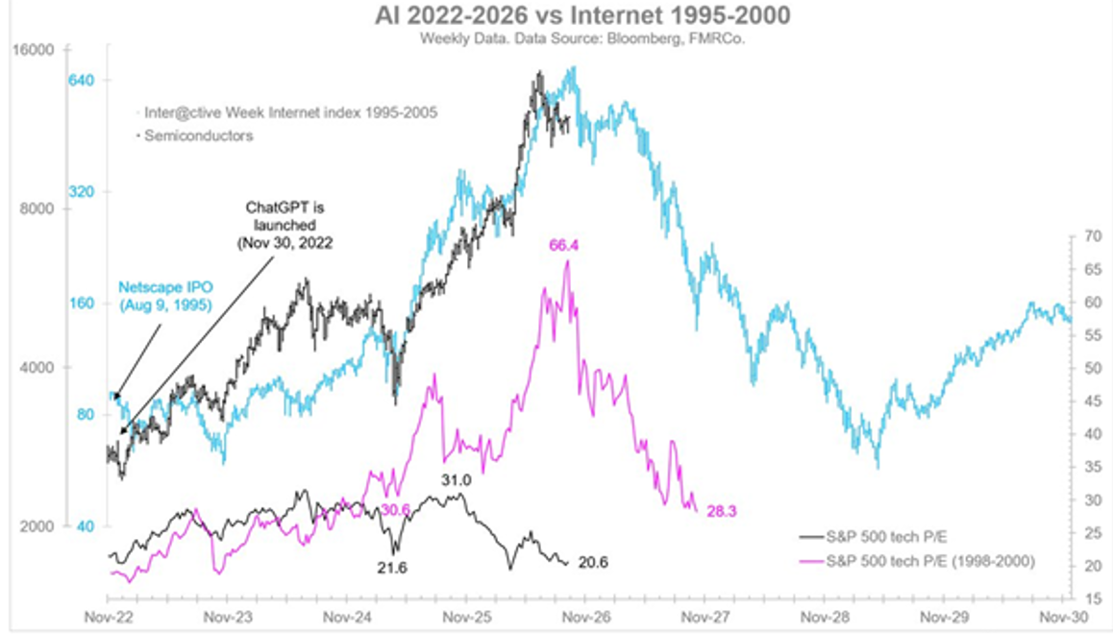
Not a valuation bubble
Internet 1995-2000 vs AI 2022-2026 (Price Return vs P/E Ratio)
Source: Fidelity - September 2026

Slide 12
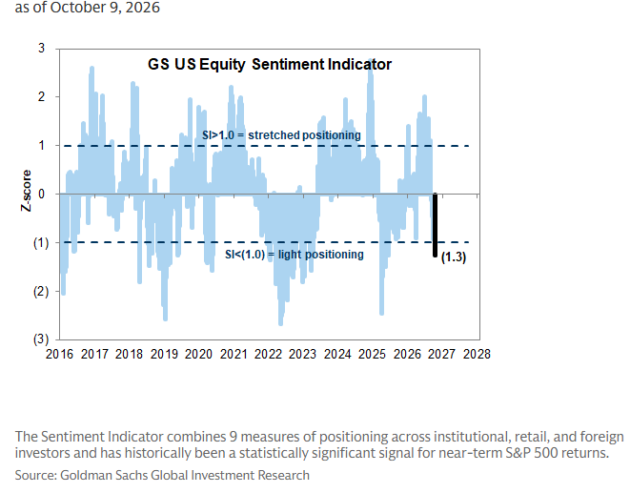
Not a sentiment bubble
Where’s the euphoria? Goldmans Sachs US Equity Sentiment Indicator
Source: Goldman Sachs - September 2026

Slide 13
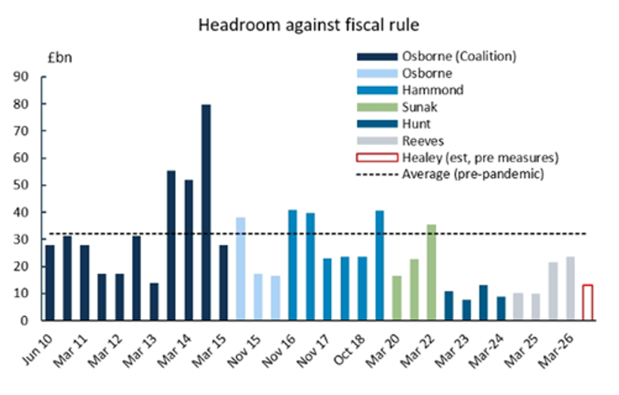
Healey’s constraint
Fiscal “headroom” estimate
Source: OBR and market estimates - September 2026

Slide 14
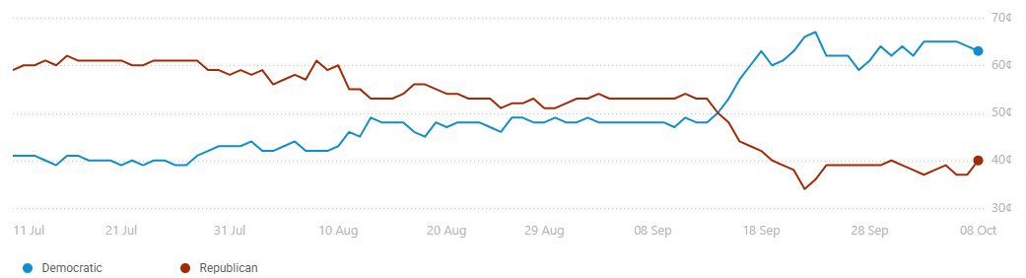
Gridlock in Washington?
Mid-term congressional elections on 3 November.
Who wins the Senate?
Source: PredictIt - 09/10/2026

Slide 15
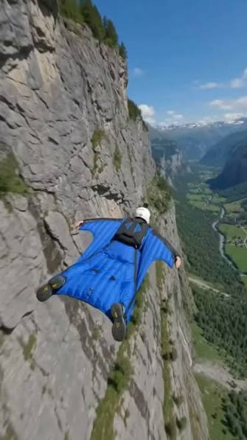
Risk is exhilarating until…
The case for balanced portfolios
Source: Chris Finck – AKA “The Flying Squirrel”

Slide 16
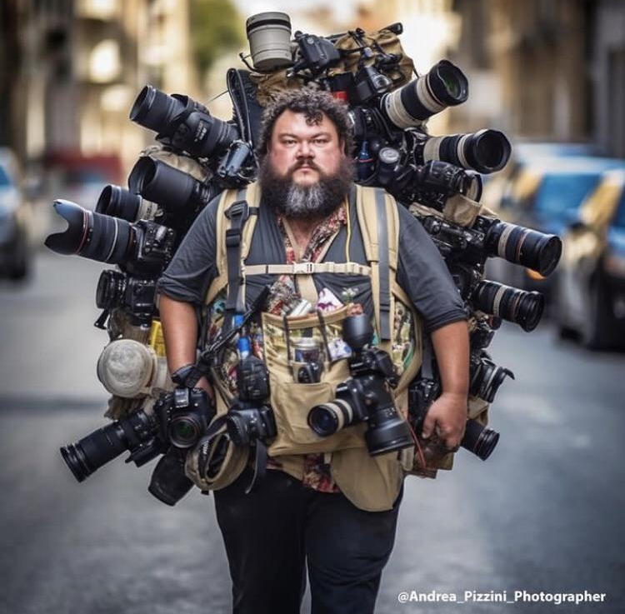
Use all the lenses!
The case for balanced portfolios
Source: Andrea Pizzini

Slide 17
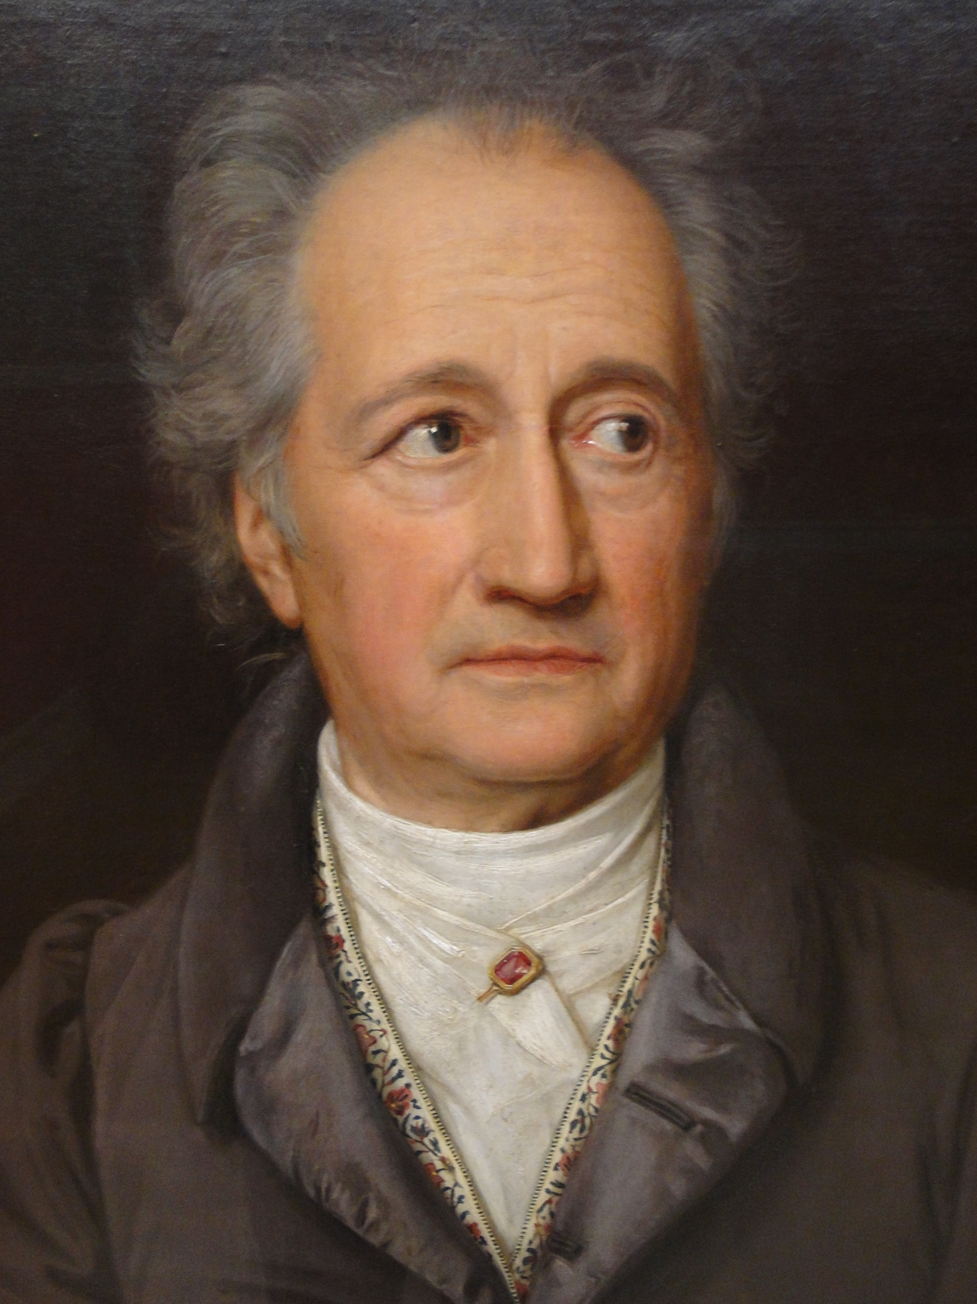
Don’t forget to enjoy it!
Goethe’s (not quite) last words
“I’ve had a happy life…
But I can’t remember a single happy week!”
Source: IMDb

Slide 18

Looking for more investment market updates?
Visit our Knowledge and Insights hub for advisers.

Slide 19
Additional information
  Rathbones Group Plc is independently owned, is the sole shareholder in each of its subsidiary businesses and is listed on the London Stock Exchange.
  Issued and approved by Rathbones Investment Management Limited, which is authorised by the Prudential Regulation Authority and regulated by the Financial Conduct Authority and the Prudential Regulation Authority. Registered office: Port of Liverpool Building, Pier Head, Liverpool L3 1NW, Registered in England No. 01448919.
  This video has been prepared by Rathbones Group Plc. We believe the information is reliable, but we can’t guarantee its accuracy or completeness. Any opinions in the video may not reflect the views held throughout Rathbones Group Plc. Nothing in this video should be taken as a recommendation.
  Rathbones Plc is not obliged to update the content after its published.
No part of this document may be reproduced in any manner without prior permission.
© 2026 Rathbones Group Plc. All rights reserved.

